Slide 1
Chess rpg (2-5+ players)

Slide 2
Classes
Bishop = Rogue
Castle = Warrior
Knight = Archer
Queen = Mage
Black king = Boss
White king = Quest master
Pawn = White or Black Minion

Slide 3
Terrains
Rocky
Grassland
Sandy
Forest
Frigid
Sweltering
Sea

Slide 4
Rules
Every character has a default range of 2
Any character can spend a turn without moving or attacking, gathering 5 stones – these are throwable items that increase ranged damage by 1. These are found in in rocky and grassland terrain.
In a go, you can move with all your speed points, then attack. But, you can’t move, then cast a spell unless you have already prepared that spell.
To prepare a spell, spend a go without attacking or moving and put a * by the spell in your spell sheet.
You only regenerate if you don’t attack that go.
You can shoot pure magic (damage) – bypassing all spell modifiers and spell preparation
Shields cannot be used with 2 handed weapons : great swords, great axes, etc. You can either wield 2 1 handed weapons or 1 2 handed weapon.
Record exp on the back of your sheet.
Armor defends magic

Slide 5
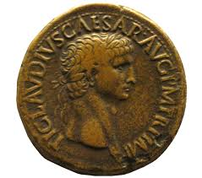
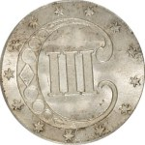
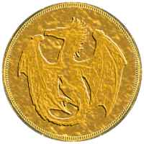
Coins
Bronze coin – these are the coins that you buy things in the shop with.
3 Bronze coins = 1 Silver coin
9 Bronze coins = 1 Gold coin
Silver coin – made of dwarven silver, mined in the Mournpeak mountains.
3 Silver coins = 1 Gold coin
1 Silver coin = 3 Bronze coins
Gold coin – pilfered long ago from a dragons hoard.
1 Gold coin = 3 Silver coins
1 Gold coin = 9 Bronze coins

Slide 6
Storyline -1 (Underneath Greenhold dungeon)
You awaken a damp, dark room with three others. Your companions seem familiar, although you have no other memories. Your mind is completely blank. Your memory has been wiped. On the other side of the room, there is an old, oak-framed door.
What do you do?
a) Wake your companions
b) Open the door
c) Look around you
A)
You shake your comrades awake – they all seem to display no knowledge of their situation or why they have lost their memories.
Do you?
c) Look around you
b) Open the door
B)
[If your companions are awake] – Slowly, you open the old door with a creak and you and your companions slip inside…
Go to Storyline -2
[If your companions are sleeping] – Slowly you peek through a crack in the door and gasp in horror – sitting cross-legged at the far end of the room is a pale skinned man – radiating a powerful aura of magic – dark magic!
Do you?
a) Wake your companions
d) Walk in alone
C)
All three of them seem to be of a different class (mage, archer and rogue) – there are no other exits to the room, and the room is just a small, concrete square
Do you?
b) Open the door
D)
You carefully walk into the darkened room… Almost instantly, the dark mage stands up and shoots a deadly stream of fire into your heart, mad peals of laughter echoing around the hollow chamber.
Game Over!
Restart Storyline -1

Slide 7
Storyline -2 (Underneath Greenhold dungeon)
Sitting cross-legged at the far end of the room is a pale skinned man – radiating a powerful aura of magic – dark magic!
Battle ‘The Mad Mage’ in rocky terrain – 8x8 board.
Have you?
Won
Lost
A)
The mage lies defeated at your feet – only one hit now would finish him for good! Suddenly, the ground starts to shake and an immense shadowy form bursts through the dungeon wall and douses the air with liquid flame. A shadow dragon! Before you have time to react, the dragon scoops up your foe in its talons and flies away – you and your companions stare in shock at the jagged hole it created in the wall and the scorched concrete of its avenging flame.
Gain:
4 Silver coins (in the group)
500 exp (per person)
Go to Storyline -3
B)
You and your companions lie defeated at the mages feet. Slowly dying.
Gain:
4 bronze coins
50 exp (per person)
Game Over
Restart Storyline -1

Slide 8
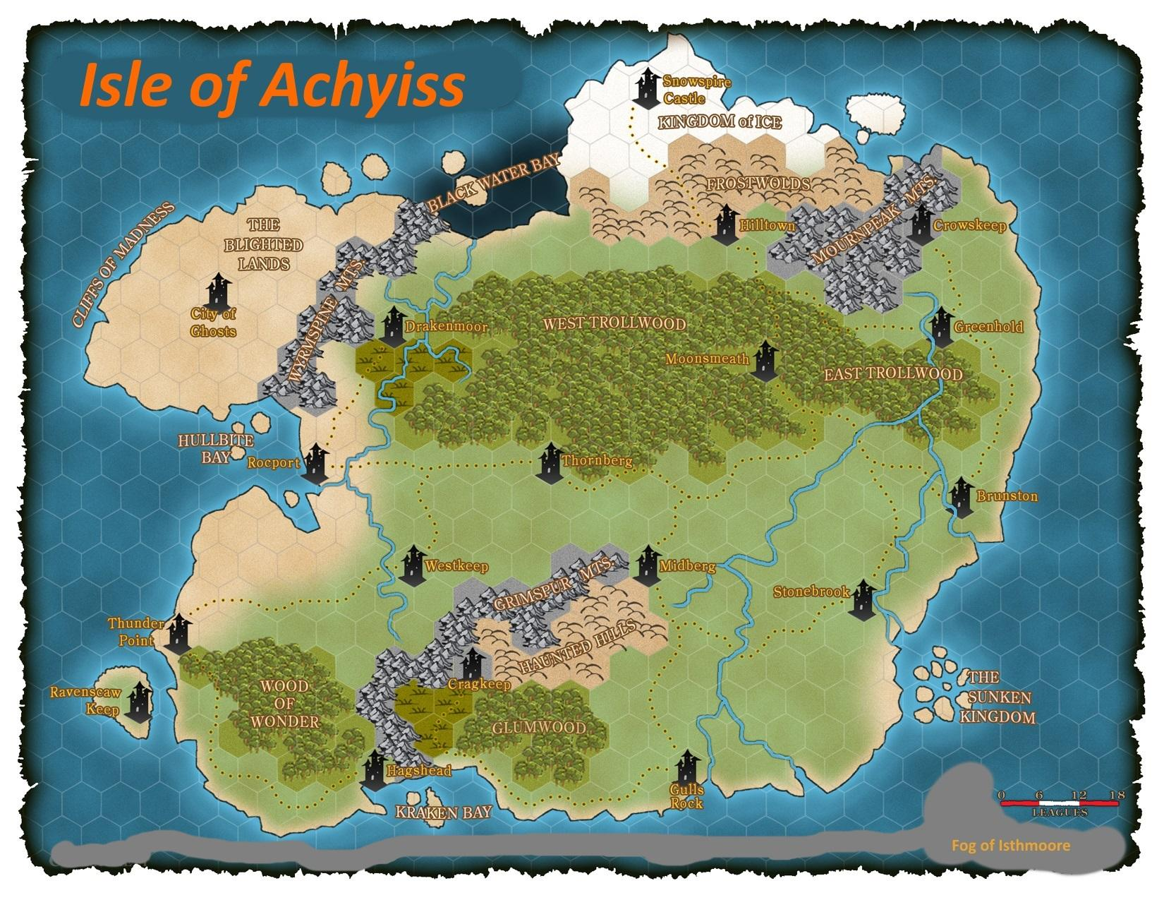

Slide 9
Special abilities
Rogue:
Can move with some of their speed points, attack, then move back with the rest of their speed points. [~/ per game]
Warrior:
Deals melee damage to every enemy in a 1 tile radius [+3 melee damage, 1 per game, must have a weapon equipped]
Mage:
Can teleport to any square in a 3 tile radius [can prepare a spell in the same turn, 1 per game]
Archer:
Increases range to 8 [+1 ranged, 1 per game]

Slide 10
Warrior
Health = __ /40
Melee damage = 2d6 + __ (weapon damage)
Ranged damage = 1d2 + __ (weapon damage)
Magic damage = 0 + __ (weapon damage)
Range = __
Defense = 1d4 + __ (armor defense)
Speed = 1 + __ (speed modifier)
Movement = Forwards, backwards, sideways
Attack pattern = Forwards, sideways, diagonally
Ranged pattern = Forwards
Natural regeneration speed = 1 + __ (regeneration modifier)
Inventory:
Armor = _____________________
Melee weapon = _______________
Ranged weapon = ______________
Magical weapon = ______________
Items:
_________________________________________________________________________________________________________________________________________________

Slide 11
Archer
Health = __ /30
Melee damage = 1d6 + __ (weapon damage)
Ranged damage = 2d6 + __ (weapon damage)
Magic damage = 0 + __ (weapon damage)
Range = __
Defense = 1d2 + __ (armor defense)
Speed = 2 + __ (speed modifier)
Movement = Forwards, backwards, sideways, diagonally
Attack pattern = Forwards, sideways
Ranged pattern = Forwards, sideways, backwards, diagonally
Natural regeneration speed = 2 + __ (regeneration modifier)
Inventory:
Armor = _____________________
Melee weapon = _______________
Ranged weapon = ______________
Magical weapon = ______________
Items:
_________________________________________________________________________________________________________________________________________________

Slide 12
Rogue
Health = __ /30
Melee damage = 2d4 + __ (weapon damage)
Ranged damage = 2d2 + __ (weapon damage)
Magic damage = 1d2 + __ (weapon damage)
Range = __
Defense = 1 + __ (armor defense)
Speed = 3 + __ (speed modifier)
Movement = Forwards, backwards, sideways, diagonally
Attack pattern = Forwards, backwards, sideways, diagonally
Ranged pattern = Forwards, sideways, backwards, diagonally
Natural regeneration speed = 3 + __ (regeneration modifier)
Inventory:
Armor = _____________________
Melee weapon = _______________
Ranged weapon = ______________
Magical weapon = ______________
Items:
_________________________________________________________________________________________________________________________________________________

Slide 13
Mage
Health = __ /20
Melee damage = 1d4 + __ (weapon damage)
Ranged damage = 1d4 + __ (weapon damage)
Magic damage = 2d6 + __ (weapon damage)
Range = __
Defense = 1d2 + __ (armor defense)
Speed = 2+ __ (speed modifier)
Movement = Forwards, backwards, diagonally
Attack pattern = Forwards, sideways
Ranged pattern = Forwards, sideways, backwards, diagonally
Natural regeneration speed = 1 + __ (regeneration modifier)
Inventory:
Armor = _____________________
Melee weapon = _______________
Ranged weapon = ______________
Magical weapon = ______________
Items:
_________________________________________________________________________________________________________________________________________________

Slide 14
Customizable character
Health = __ /__
Melee damage = _d_ + __ (weapon damage)
Ranged damage = _d_ + __ (weapon damage)
Magic damage = _d_ + __ (weapon damage)
Range = __
Defense = _d_ + __ (armor defense)
Speed = _d_ + __ (speed modifier)
Movement = ________, _________, _________, _________
Attack pattern = ________, _________, _________, _________
Ranged pattern =________, _________, _________, _________
Natural regeneration speed = _d_ + __ (regeneration modifier)
Inventory:
Armor = _____________________
Melee weapon = _______________
Ranged weapon = ______________
Magical weapon = ______________
Items:
_________________________________________________________________________________________________________________________________________________

Slide 15
Black Minions
Inventory:
Armor = _____________________
Melee weapon = _______________
Ranged weapon = ______________
Magical weapon = ______________
Items:
_________________________________________________________________________________________________________________________________________________
Health = __ / __ (5 per individual)
Melee damage = 1d2 + 1
Ranged damage = 1d2 + 1
Range = __
Magic damage = 0
Defense = 1d2
Speed = 1
Movement = Forwards, sideways, backwards, diagonally
Attack pattern = Forwards, sideways, backwards, diagonally
Ranged pattern = Forwards, sideways, backwards, diagonally

Slide 16
White Minions
Inventory:
Armor = _____________________
Melee weapon = _______________
Ranged weapon = ______________
Magical weapon = ______________
Items:
_________________________________________________________________________________________________________________________________________________
Health = __ / __ (5 per individual)
Melee damage = 1d2 + 1
Ranged damage = 1d2 + 1
Range = __
Magic damage = 0
Defense = 1d2
Speed = 1
Movement = Forwards, sideways, backwards, diagonally
Attack pattern = Forwards, sideways, backwards, diagonally
Ranged pattern = Forwards, sideways, backwards, diagonally

Slide 17
Customizable Minions
Inventory:
Armor = _____________________
Melee weapon = _______________
Ranged weapon = ______________
Magical weapon = ______________
Items:
_________________________________________________________________________________________________________________________________________________
Health = __ / __ ( __ per individual)
Melee damage = __d__ + __
Ranged damage = __d__ + __
Range = __
Magic damage = __d__ + __
Defense = __d__
Speed = __ + __
Movement = ________, _________, _________, _________
Attack pattern = ________, _________, _________, _________
Ranged pattern = ________, _________, _________, _________

Slide 18
The Mad Mage
Inventory:
Armor = _____________________
Melee weapon = _______________
Ranged weapon = ______________
Magical weapon = ______________
Items:
_________________________________________________________________________________________________________________________________________________
Health = __ /30
Melee damage = 3d6
Ranged damage = 0
Range = __
Magic damage = 4d4
Defense = 1d4 +1
Speed = 1
Movement = Forwards, sideways, backwards, diagonally
Attack pattern = Forwards, sideways, backwards, diagonally
Ranged pattern = Forwards, sideways, backwards, diagonally

Slide 19
Customizable Boss
Inventory:
Armor = _____________________
Melee weapon = _______________
Ranged weapon = ______________
Magical weapon = ______________
Items:
_________________________________________________________________________________________________________________________________________________
Health = __ /__
Melee damage = __d__+ __
Ranged damage = __d__+ __
Range = __
Magic damage = __d__ + __
Defense = __d__ + __
Speed = __+ __
Movement = ________, _________, _________, _________
Attack pattern = ________, _________, _________, _________
Ranged pattern =________, _________, _________, _________

Slide 20
Spell sheets
Name = Warrior
Mana = 0/0
Mana regeneration = 0
Spells:
_____________________
_____________________
_____________________
_____________________
_____________________
______________________
Name = Archer
Mana = 0/0
Mana regeneration = 0
Spells:
_____________________
_____________________
_____________________
_____________________
_____________________
Name = Rogue
Mana = 0/6
Mana regeneration = 1
Spells:
_____________________
_____________________
_____________________
_____________________
_____________________
Name = Mage
Mana = 0/10
Mana regeneration = 2
Spells:
_____________________
_____________________
_____________________
_____________________
_____________________

Slide 21
Spell sheets
Name = The Mad Mage
Mana = 5/5
Mana regeneration = 1
Spells:
Fireball
Summon army
Name = _______
Mana = __/__
Mana regeneration = ___
Spells:
_____________________
_____________________
_____________________
_____________________
_____________________
Name = _______
Mana = __/__
Mana regeneration = ___
Spells:
_____________________
_____________________
_____________________
_____________________
_____________________
Name = _______
Mana = __/__
Mana regeneration = ___
Spells:
_____________________
_____________________
_____________________
_____________________
_____________________

Slide 22
Spells
Summon minion = Spawns 1 minion of your color = 6 coins = 2 mana[mage, boss]
Sparks = +1 magic = 3 range = 4 coins = 1 mana[rogue, mage, boss]
Fireball = +2 magic = 5 range = 6 coins = 2 mana[rogue, mage, boss]
Heal = +5 health = 4 coins = 1 mana[mage, boss]
Summon army = Spawns 3 minions of your color = 14 coins = 5 mana[mage, boss]
Flight = +1 speed = can go over (through enemies) = +1 defense = 18 coins = 6 mana [rogue mage boss]
Necromancy = +5 health whenever your enemy dies = N/A = 5 mana[mage, boss]
Duplication = Duplicate a unit of any class on the board, roll 1d2: 1 = the unit is on your side, otherwise it is an enemy (the copy shares the originals character sheet but the health score) = N/A = 8 mana[boss]
Time Warp = Retrace your last go = 5 mana = 8 coins = [rogue, mage, boss]

Slide 23
Weapons
Knife = +1 attack = 2 coins
Short bow = +1 ranged = 3 range = 3 coins [2 handed]
Wooden staff = +1 magic = 1 coin
Dagger = +2 attack = 3 coins
Crossbow = +2 ranged = 3 range = 4 coins [2 handed]
Long bow = +1 ranged = 4 range = 4 coins [2 handed]
Ancient staff = +2 magic = 2 coins
Short sword = +2 attack = 3 coins
Great sword = +4 attack = 6 coins [2 handed]
Great axe = +3 attack = 4 coins [2 handed]
Battle axe = +3 attack = 5 coins

Slide 24
Armor
Leather armor = +1 defense = 1 coin
Chainmail armor = +2 defense = 2 coins
Plate mail armor = +3 defense = 3 coins
Hardened plate mail armor = +5 defense = 5 coins
Dragon scale armor = +7 defense = N/A
Hardened dragon scale armor = +10 defense = N/A
Silken armor = +1 defense = +1 speed = 5 coins
Mages robes = +1 defense = +1 magic = 4 coins
Mages robes = +1 defense = +1 magic = 4 coins

Slide 25
Items
Iron ring = +1 max-health = 2 coins
Crystal ring = +1 max-mana = 2 coins
Leather gauntlets = +1 attack = 2 coins
Silver necklace = +1 ranged = 2 coins
Amber broach = +1 max-range = 3 coins
Crystal talisman = +1 mana regeneration = N/A
Shadow woven cloak = +1 defense = +1 speed N/A
Cobweb gauntlets = +1 magic damage = 2 coins
Iron shield = +2 defense = 5 coins
Steel shield = +3 defense = 7 coins
Dragon scale shield = +6 defense = N/A
Obsidian pendant = +2 natural regeneration = 7 coins

